Slide 1
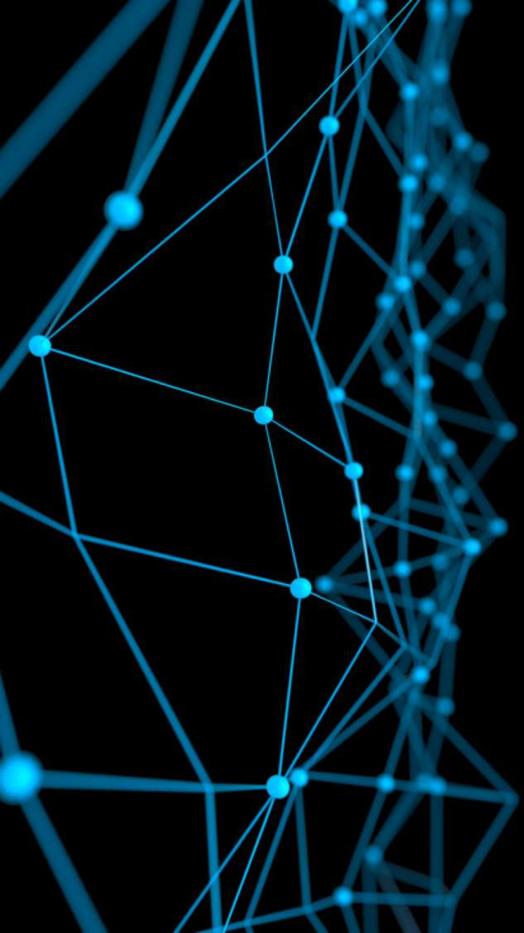
Deep Learning for Computer Vision
Convolution Neural Network
Rang Nguyen
June 2019

Slide 2
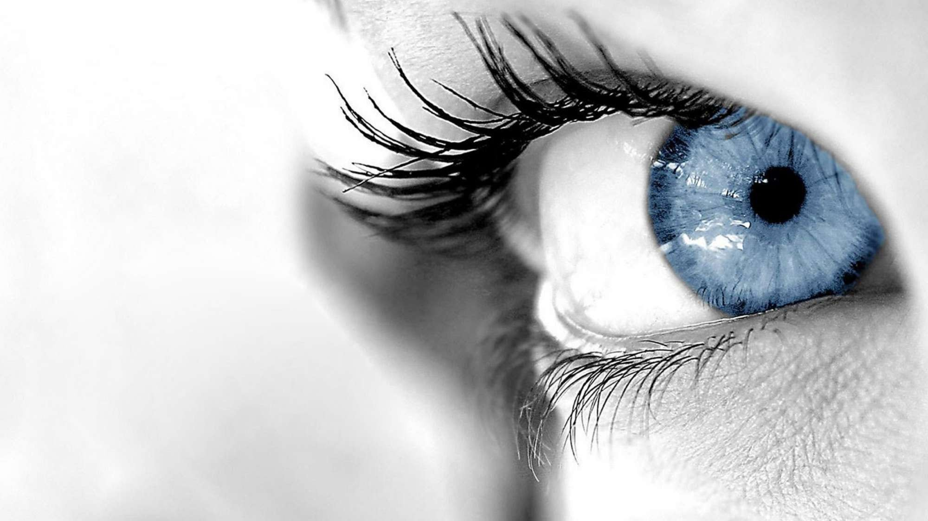
6.S191 Introduction to Deep Learning
introtodeeplearning.com ^{1/29/19}

Slide 3
What Computers “See”

Slide 4
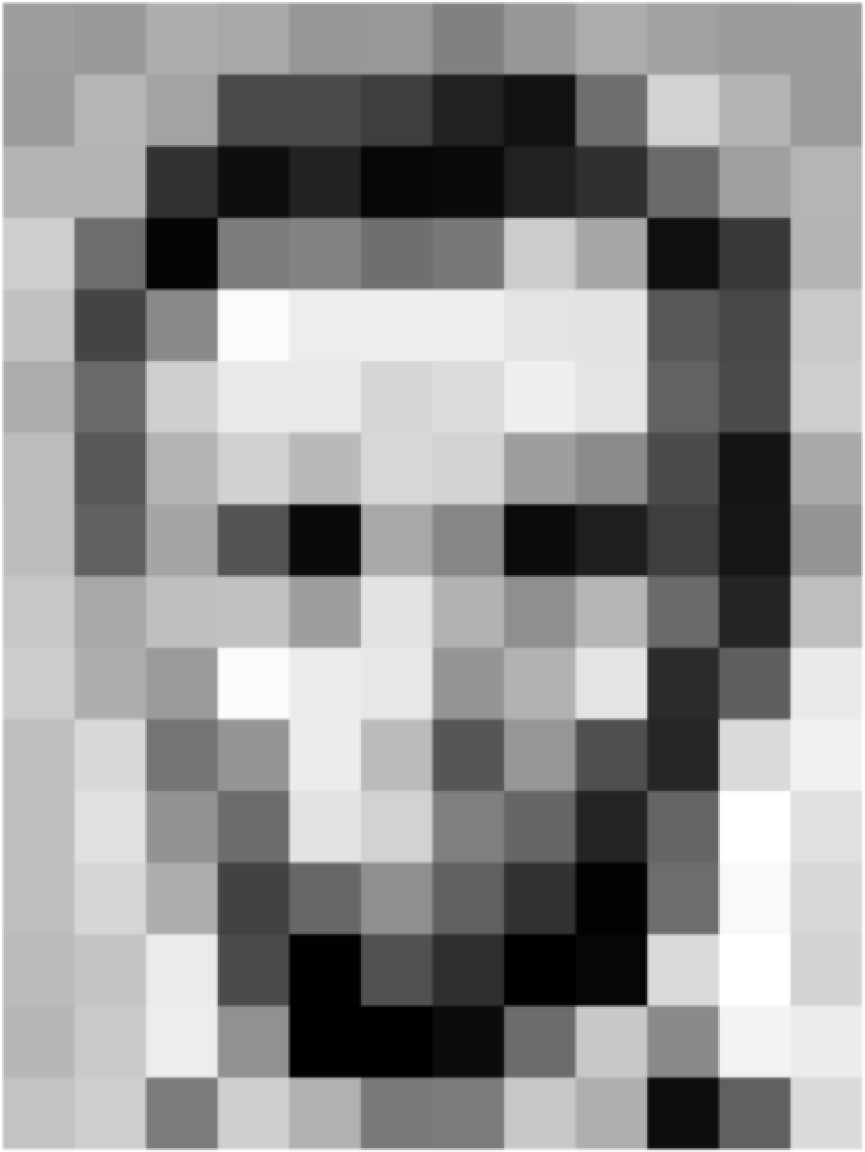
Images are Numbers
[1] 1/29/19

Slide 5
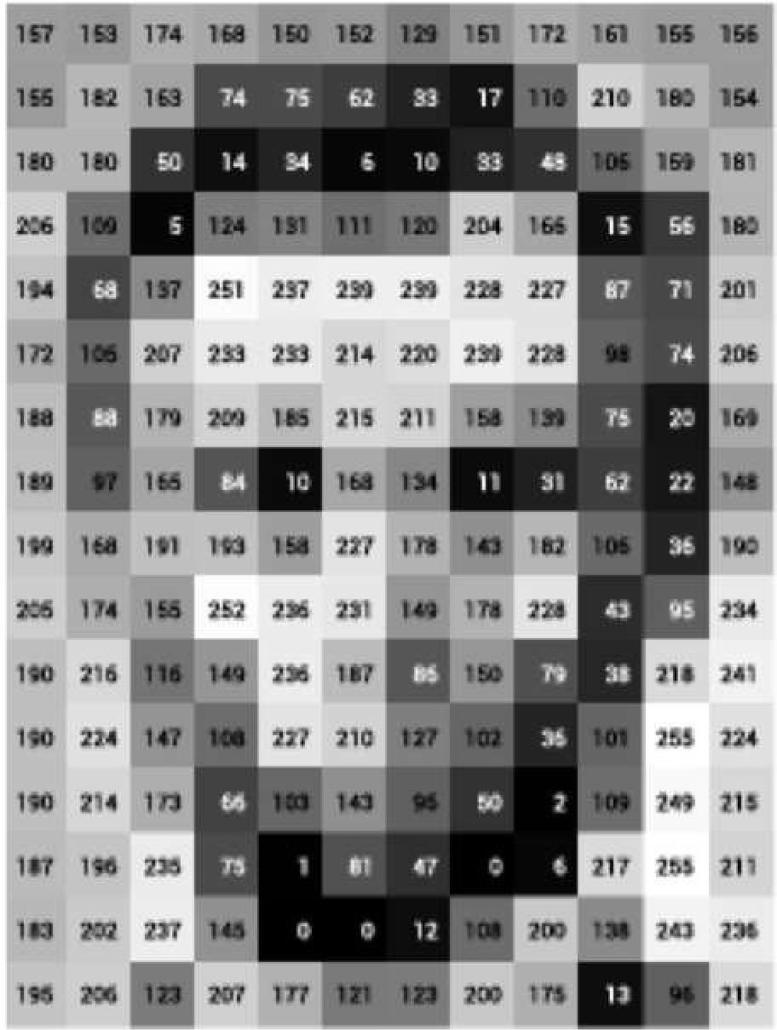
Images are Numbers
[1] 1/29/19

Slide 6
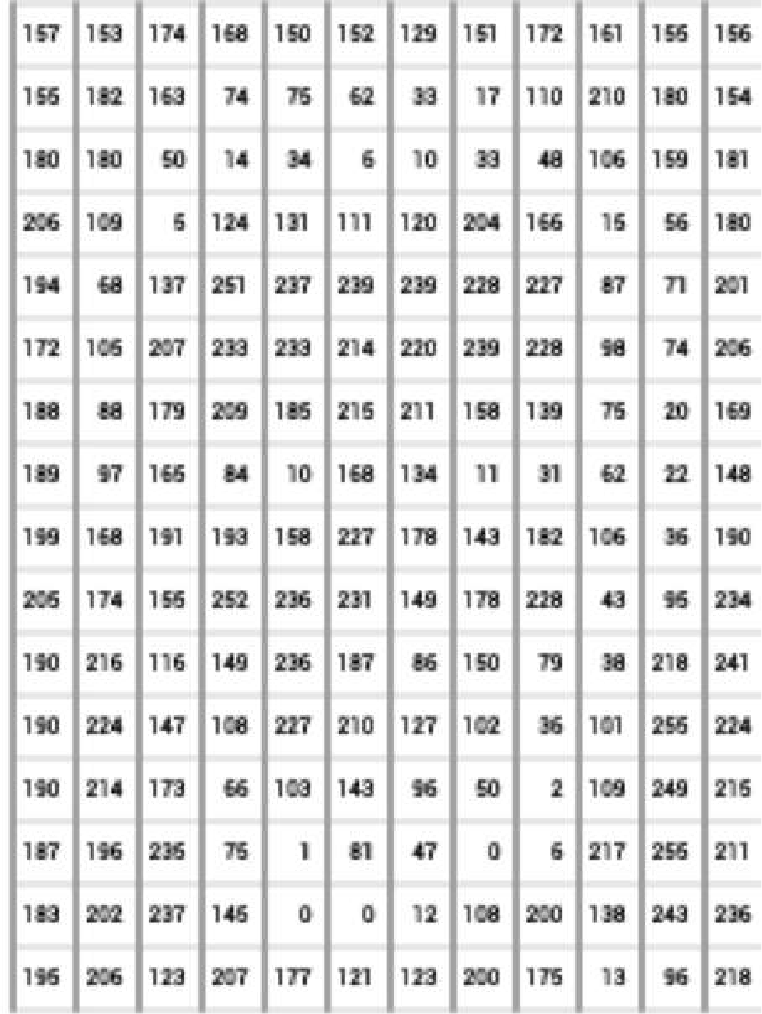
Images are Numbers
What the computer sees
An image is just a matrix of numbers [0,255]! i.e., 1080x1080x3 for an RGB image
[1] 1/29/19

Slide 7
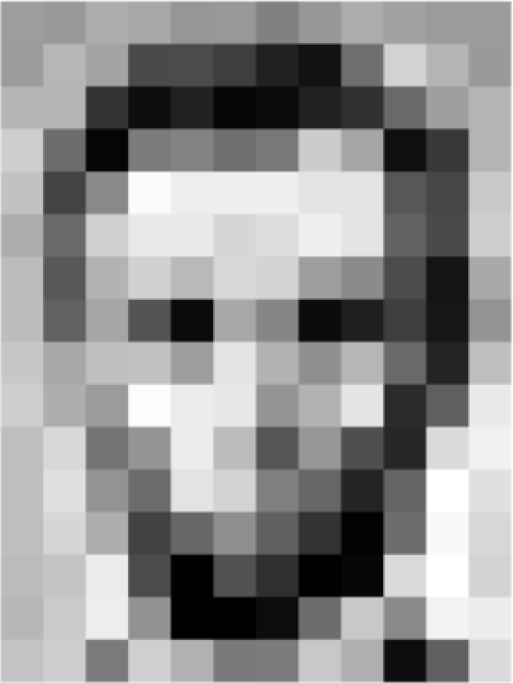
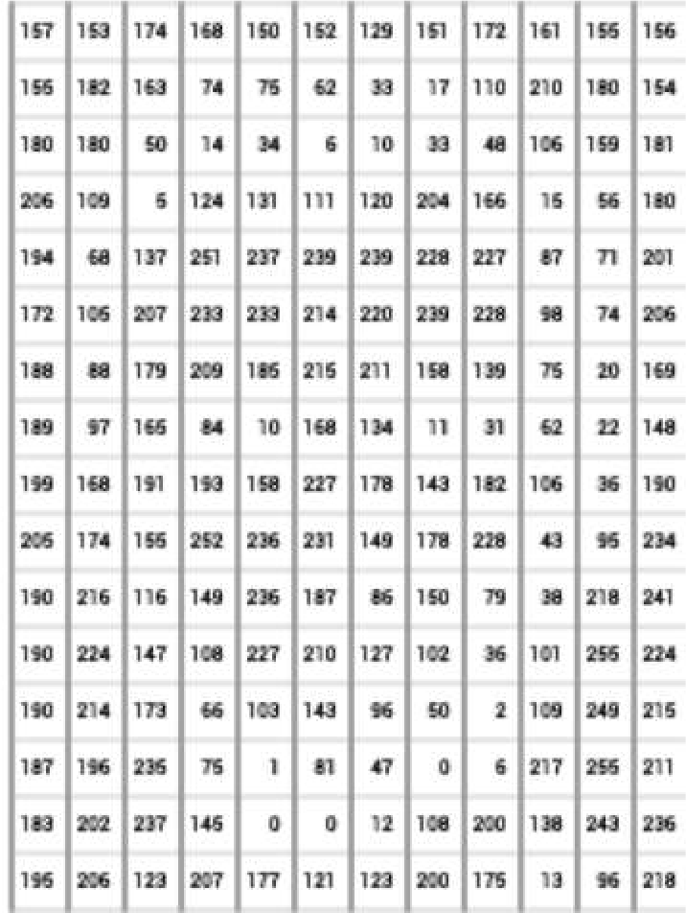
Tasks in Computer Vision
Lincoln
0.8
Washington
0.1
classification
Jefferson
0.05
Obama
0.05
Input Image Pixel Representation
Regression: output variable takes continuous value
Classification: output variable takes class label. Can produce probability of belonging to a particular class
1/29/19

Slide 8
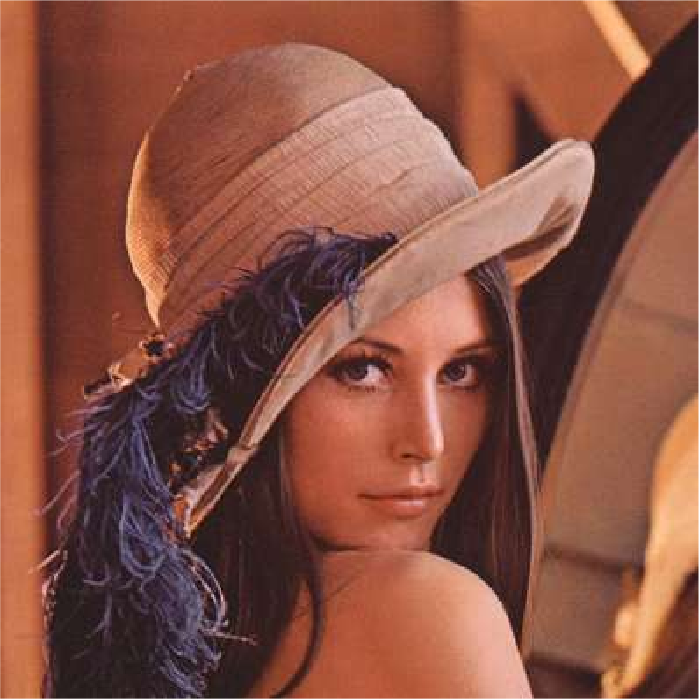

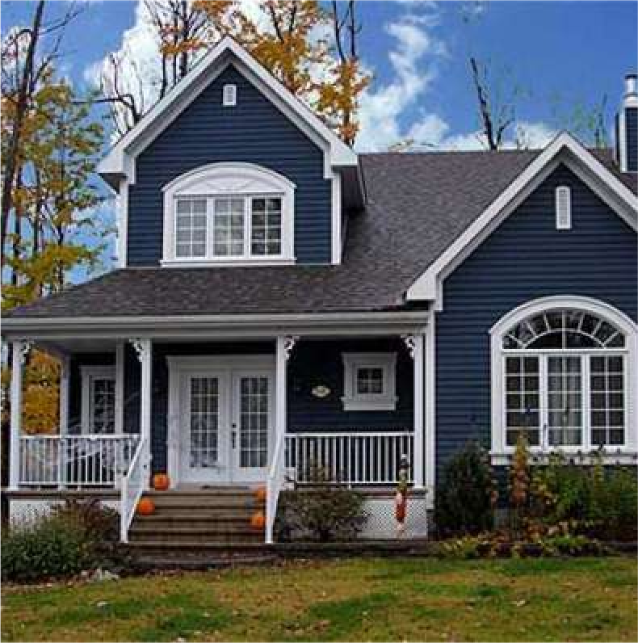
High Level Feature Detection
Let’s identify key features in each image category
Nose, Eyes, Mouth
Wheels, License Plate, Headlights
Door, Windows, Steps
1/29/19

Slide 9
Manual Feature Extraction
Detect features to classify
Domain knowledge
Define features
Problems?
1/29/19

Slide 10
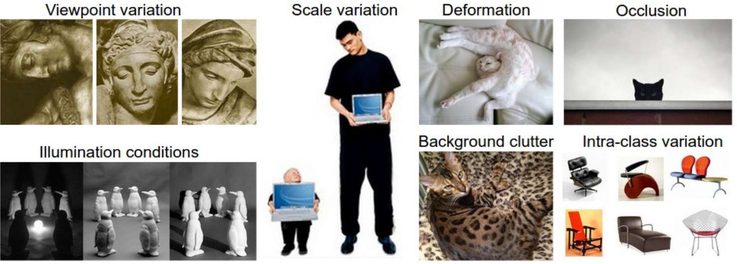
Manual Feature Extraction
Detect features to classify
Domain knowledge
Define features
[2] 1/29/19

Slide 11
Manual Feature Extraction
Detect features to classify
Domain knowledge Define features
[2] 1/29/19

Slide 12
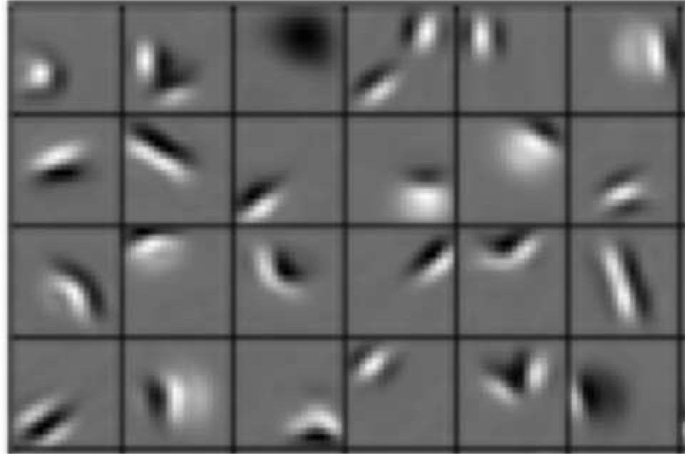
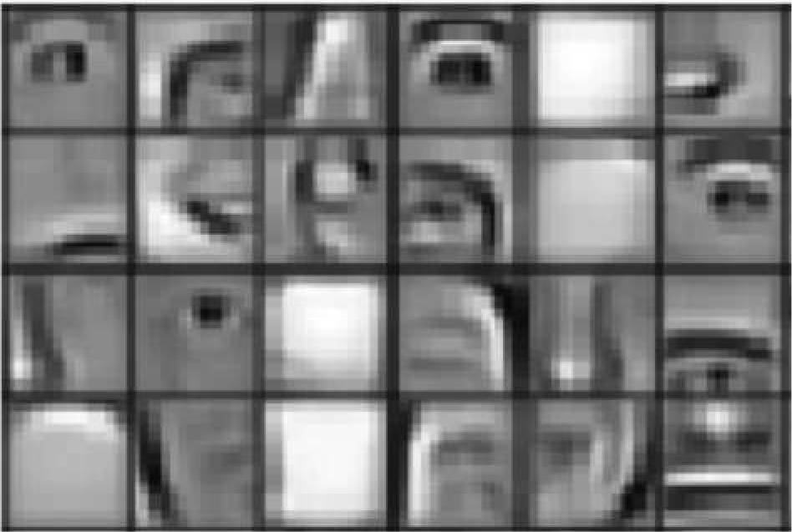
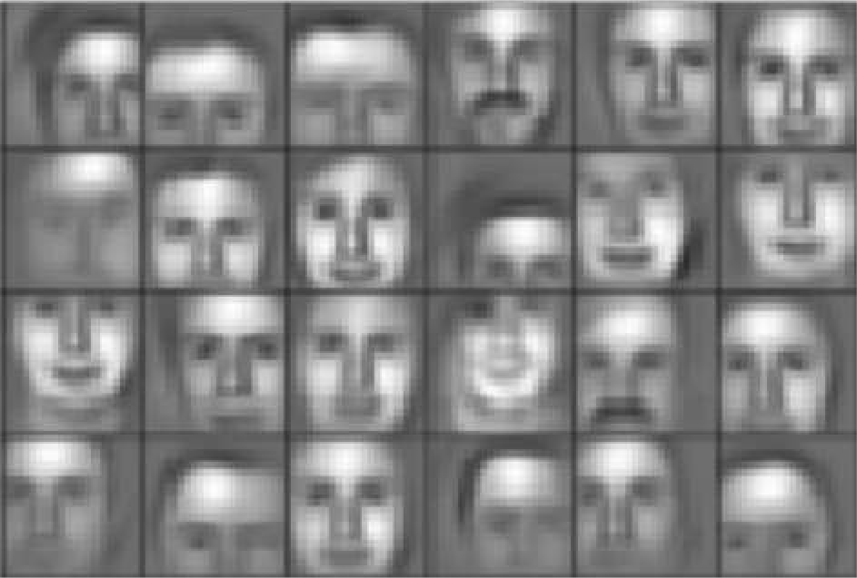
Learning Feature Representations
Can we learn a hierarchy of features directly from the data instead of hand engineering?
Low level features Mid level features High level features
Edges, dark spots
Eyes, ears, nose
Facial structure
[3] 1/29/19

Slide 13
Learning Visual Features

Slide 14
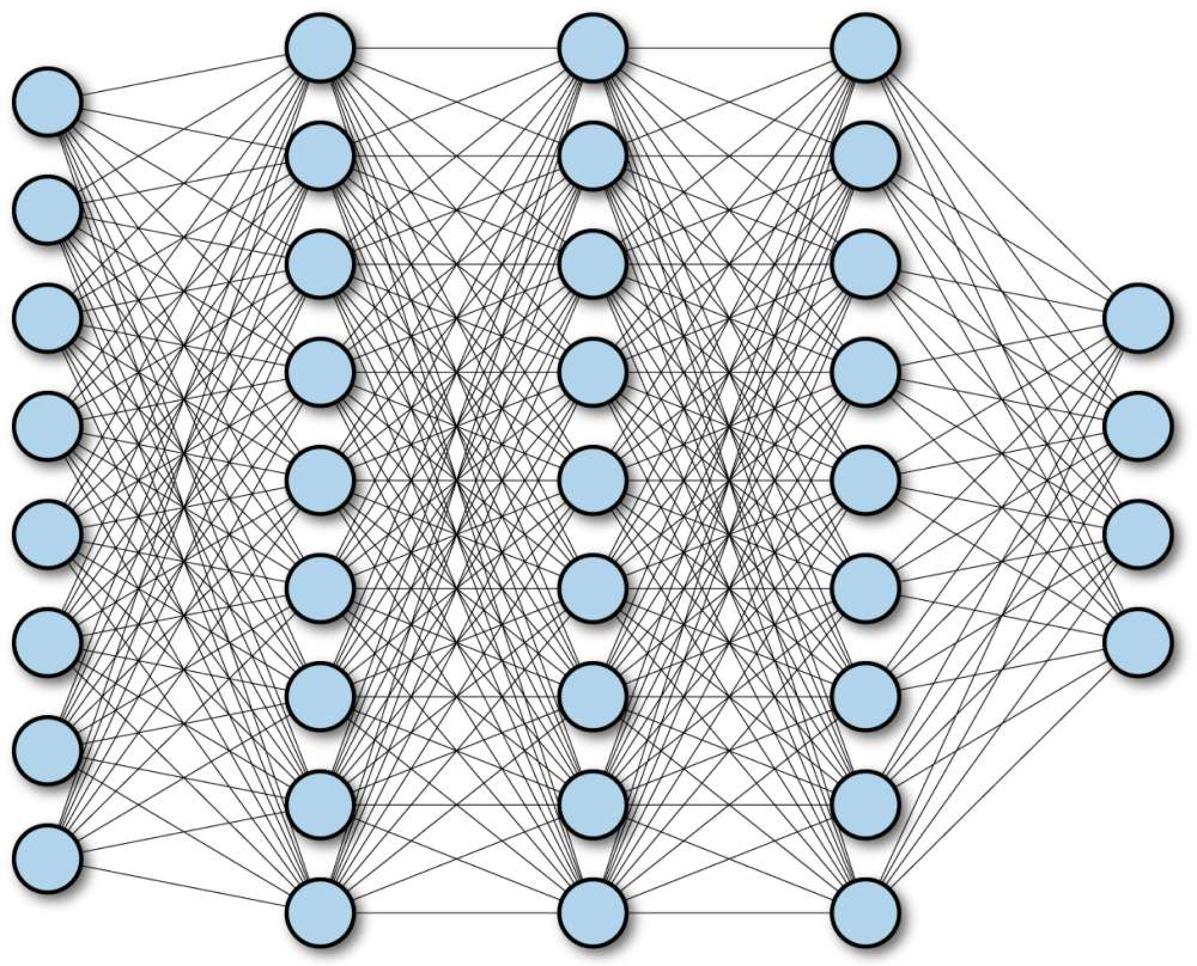
Fully Connected Neural Network
1/29/19

Slide 15
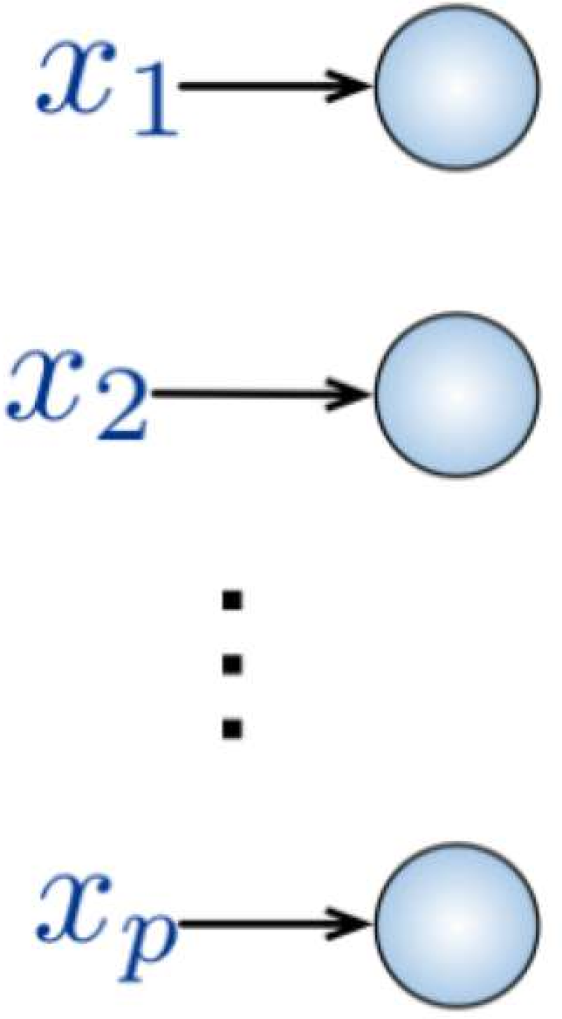
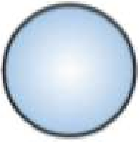
Fully Connected Neural Network
Input:
2D image
Vector of pixel values
Fully Connected:
Connect neuron in hidden layer to all neurons in input layer
No spatial information!
And many, many parameters!
1/29/19

Slide 16
Fully Connected Neural Network
Input:
2D image
Vector of pixel values
Fully Connected:
Connect neuron in hidden layer to all neurons in input layer
No spatial information!
And many, many parameters!
How can we use spatial structure in the input to inform the architecture of the network?
1/29/19

Slide 17
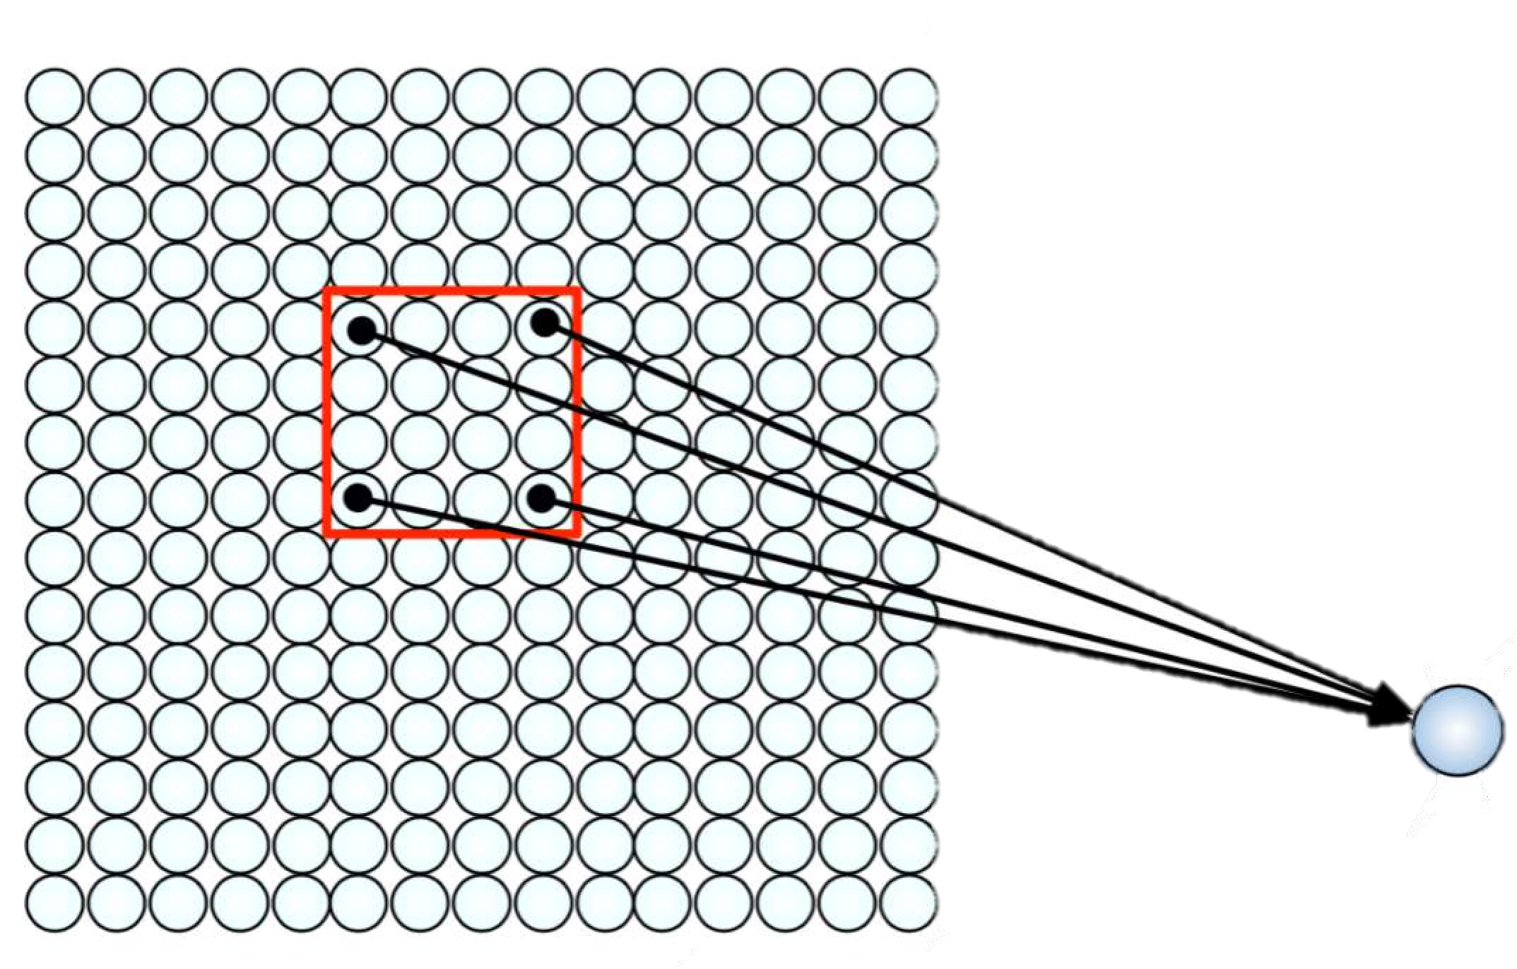
Using Spatial Structure
Input: 2D image.
Array of pixel values
Idea: connect patches of input to neurons in hidden layer.
Neuron connected to region of input. Only “sees” these values.
1/29/19

Slide 18
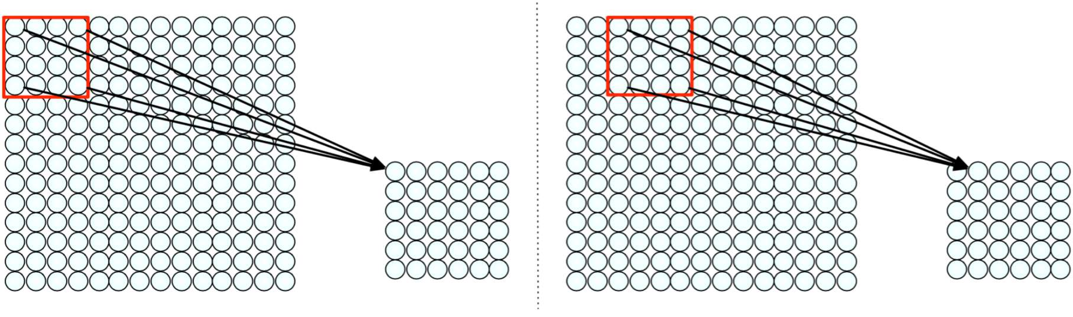
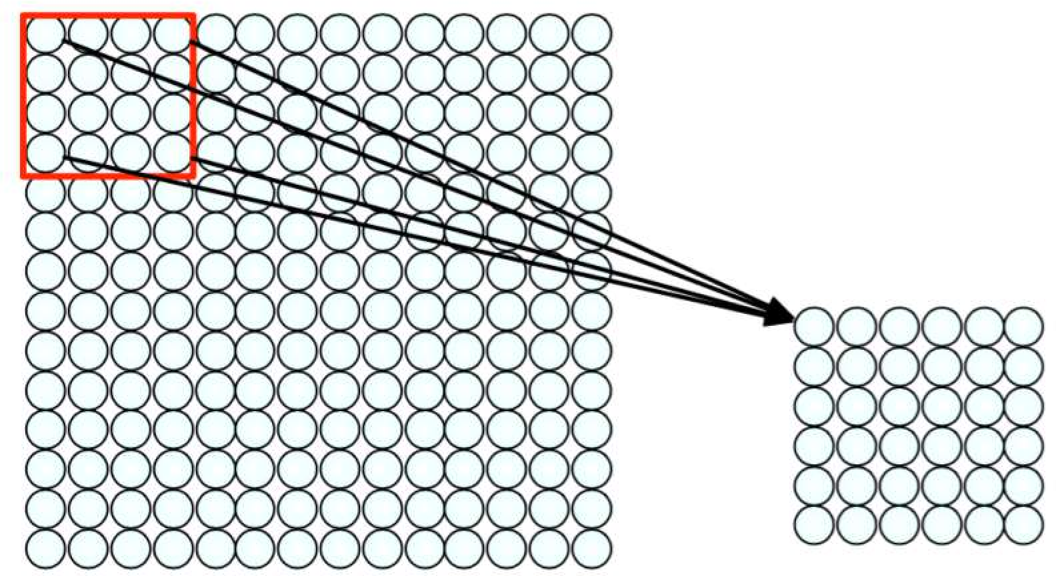
Using Spatial Structure
Connect patch in input layer to a single neuron in subsequent layer.
Use a sliding window to define connections.
How can we weight the patch to detect particular features?
1/29/19

Slide 19
Applying Filters to Extract Features
Apply a set of weights – a filter – to extract local features
Use multiple filters to extract different features
Spatially share parameters of each filter
(features that matter in one part of the input should matter elsewhere)
1/29/19

Slide 20
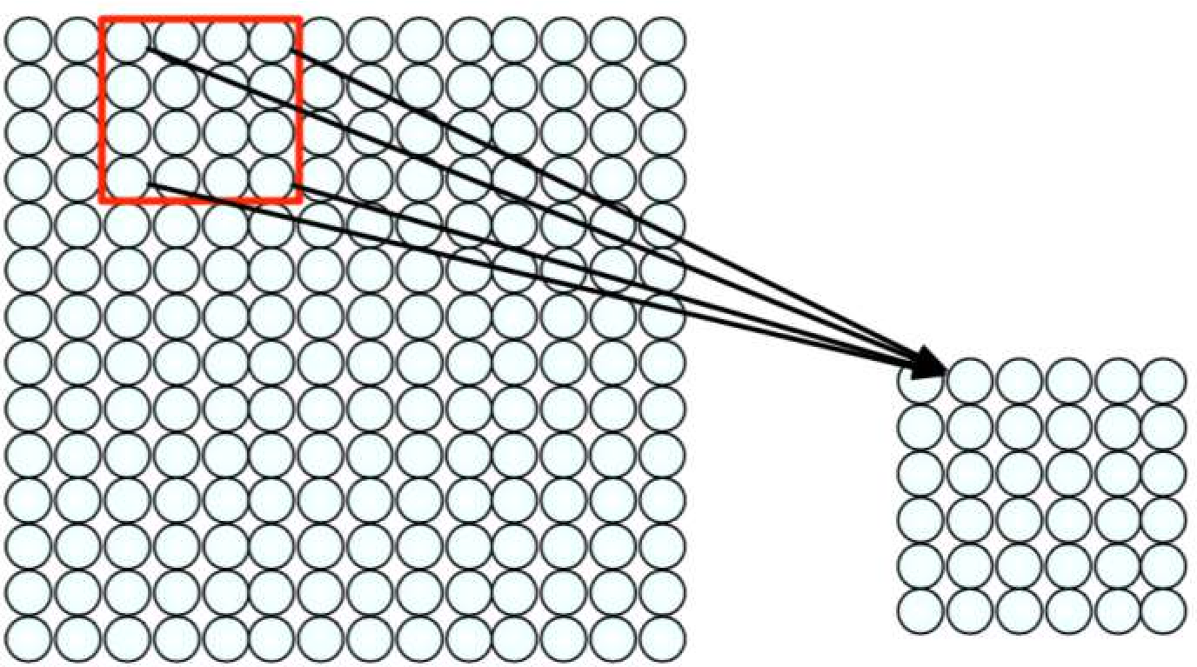
Feature Extraction with Convolution
Filter of size 4x4 : 16 different weights
Apply this same filter to 4x4 patches in input
Shift by 2 pixels for next patch
This “patchy” operation is convolution
Apply a set of weights – a filter – to extract local features
Use multiple filters to extract different features
Spatially share parameters of each filter
1/29/19

Slide 21
Feature Extraction and Convolution A Case Study

Slide 22
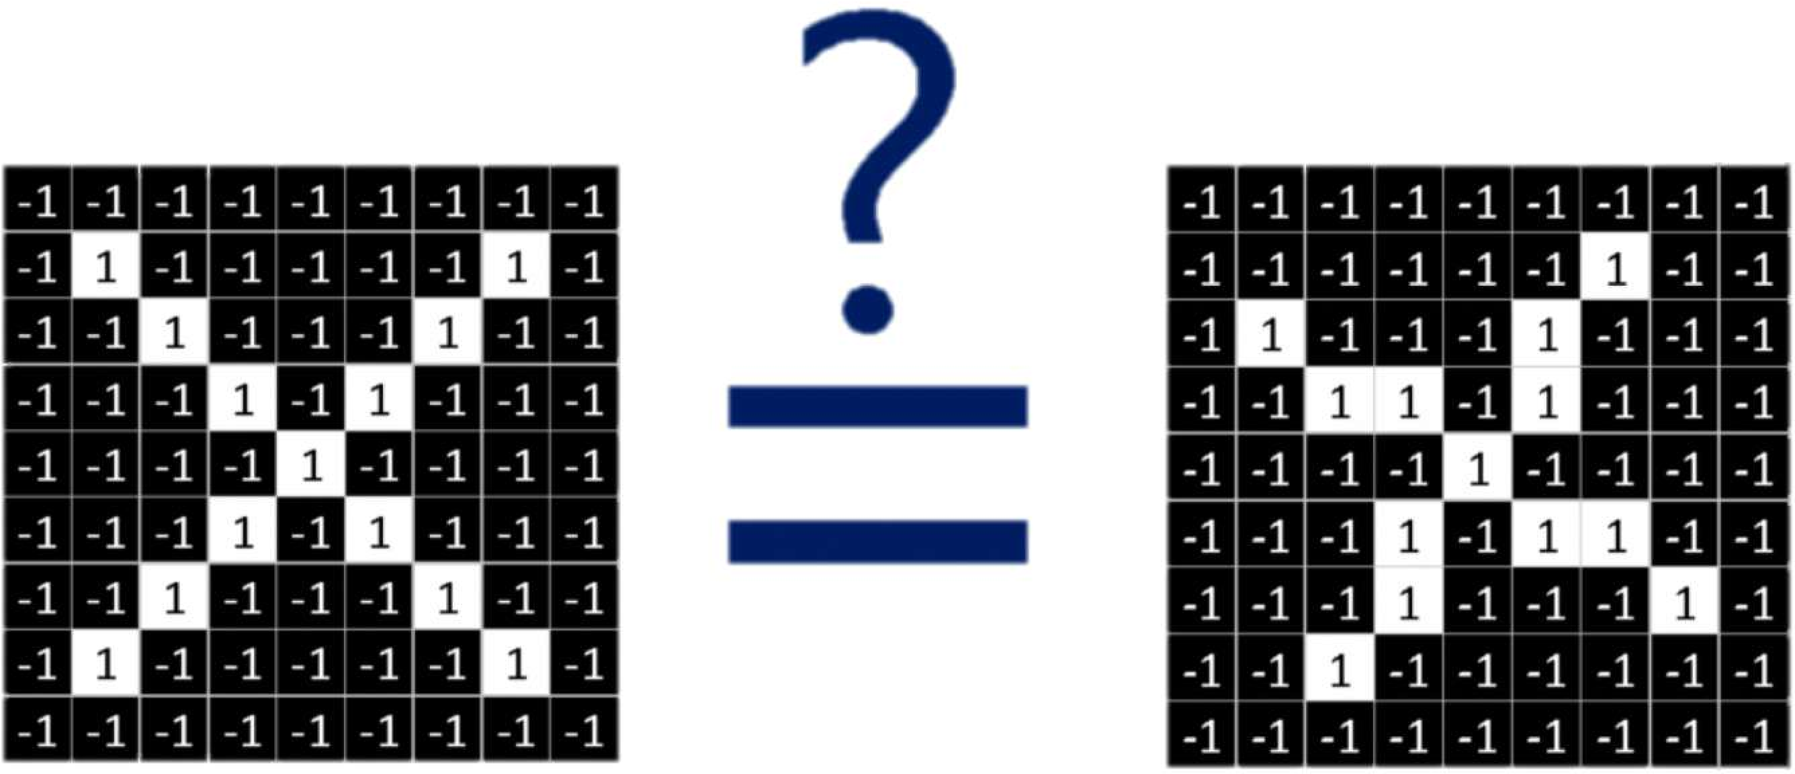
X or X?
Image is represented as matrix of pixel values… and computers are literal!
We want to be able to classify an X as an X even if it’s shifted, shrunk, rotated, deformed.
[4] 1/29/19

Slide 23
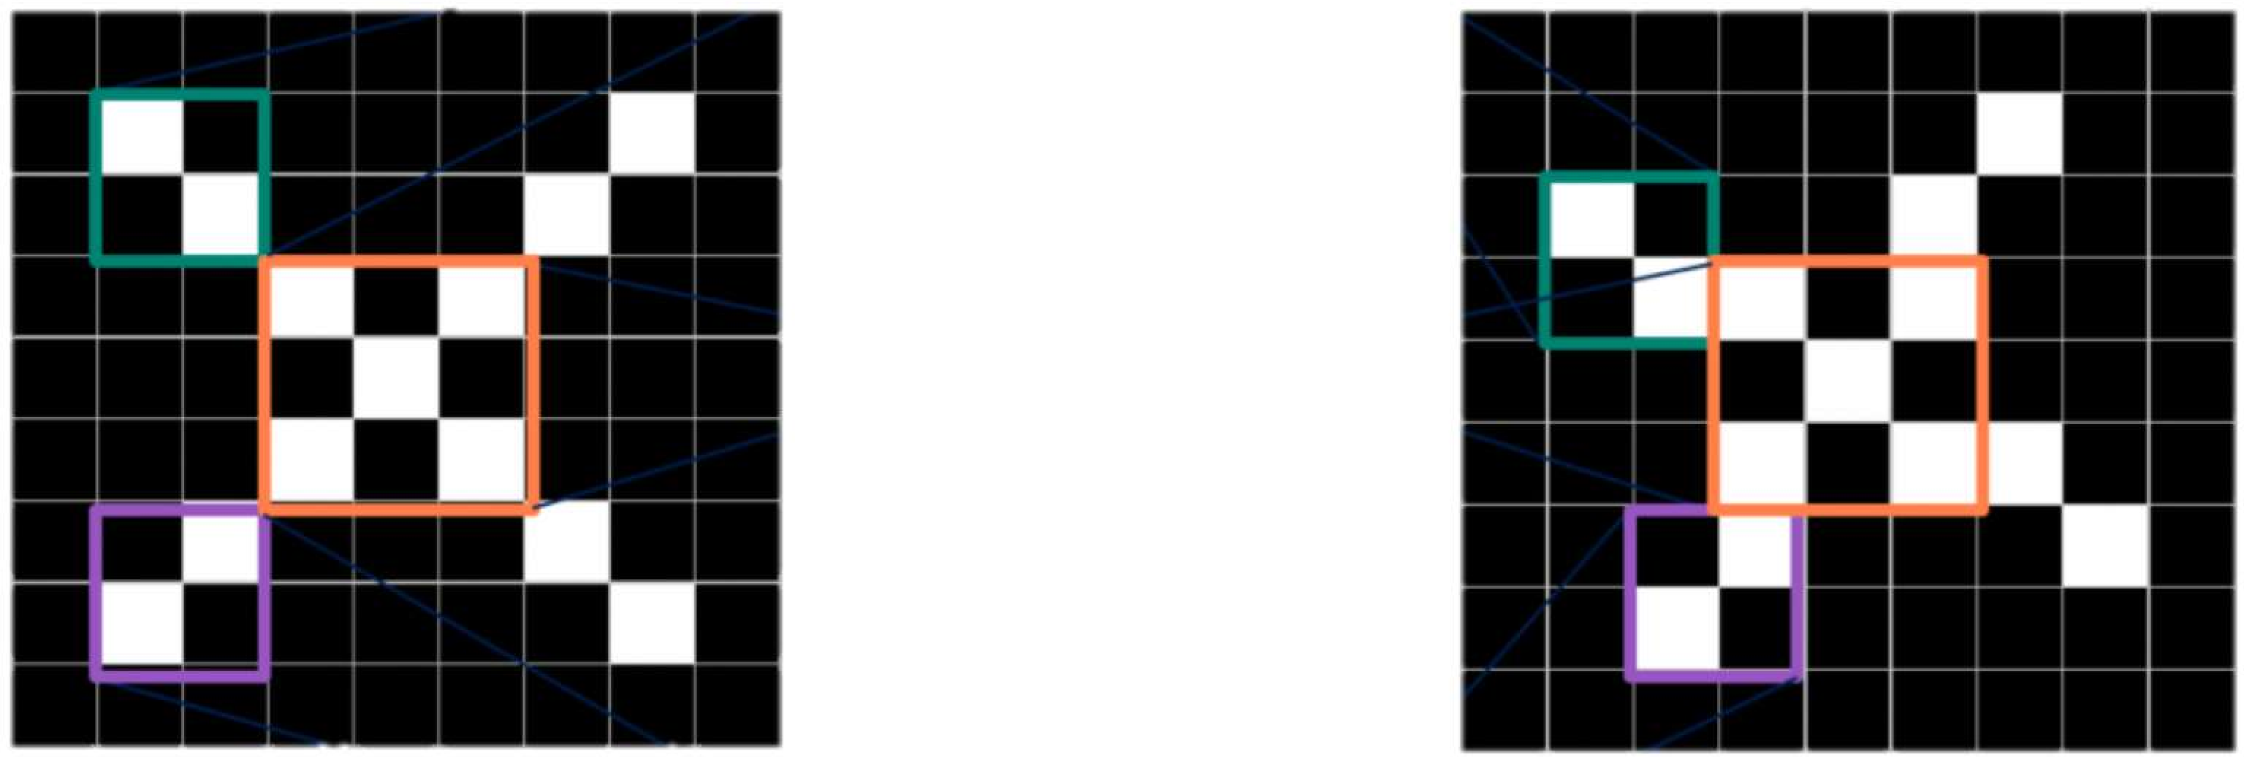
Features of X
[4] 1/29/19

Slide 24
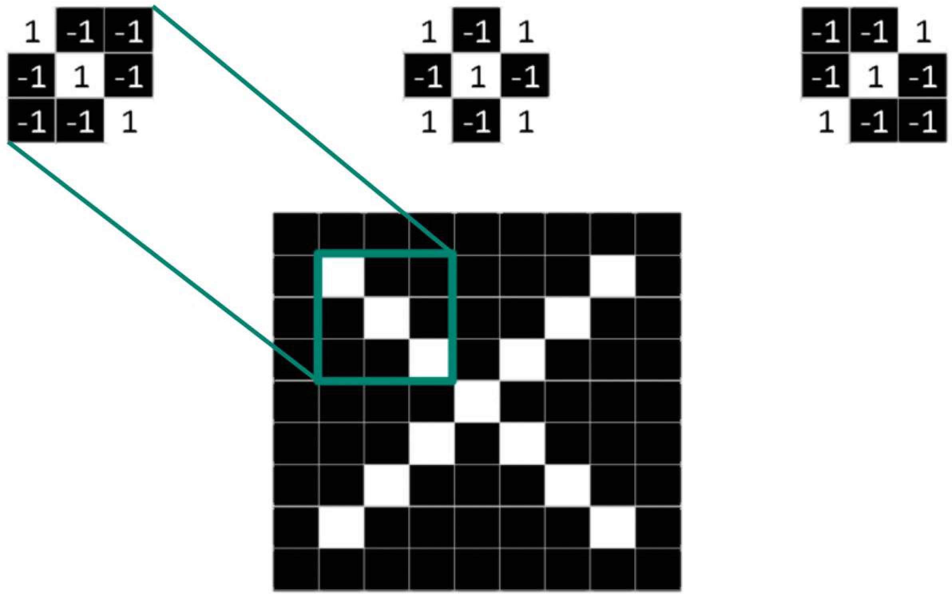
Filters to Detect X Features
filters
[4] 1/29/19

Slide 25
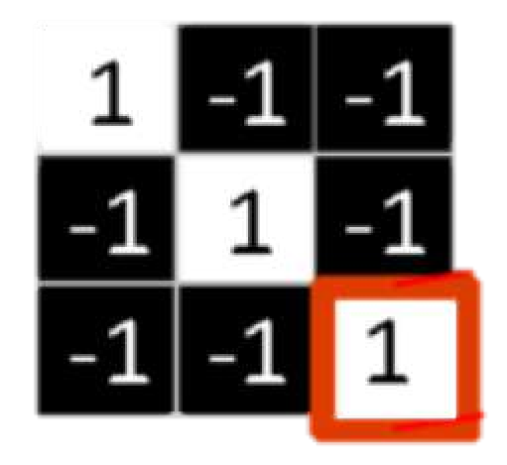
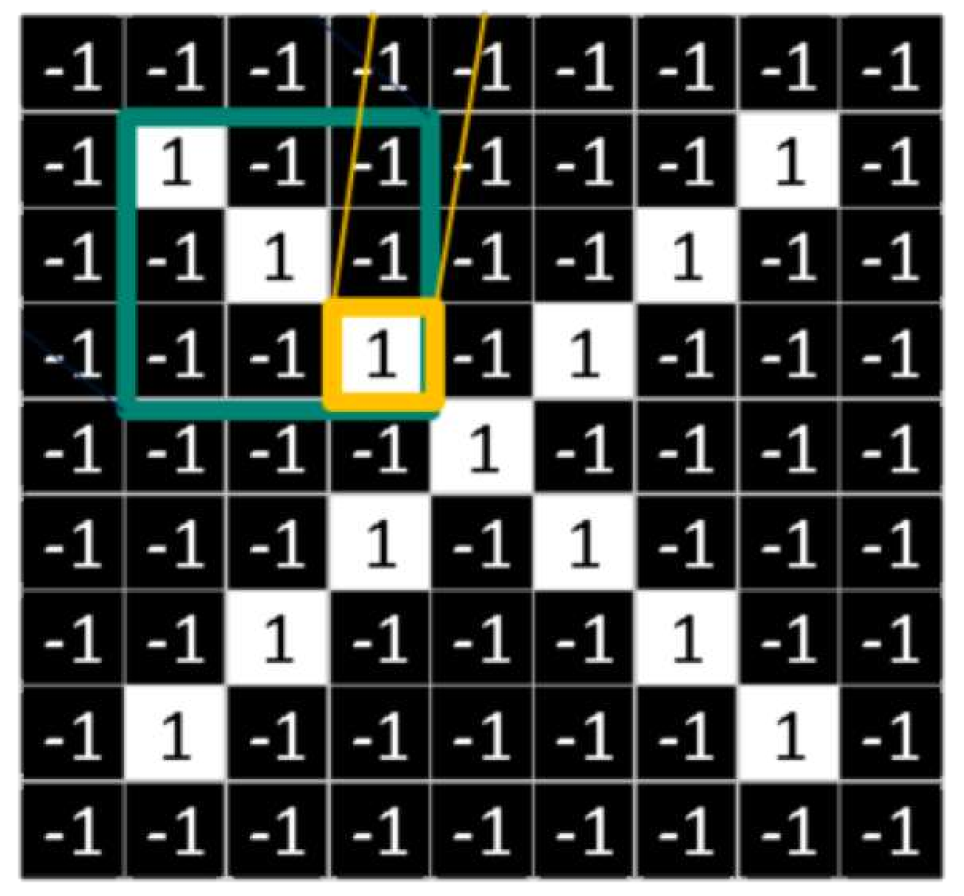
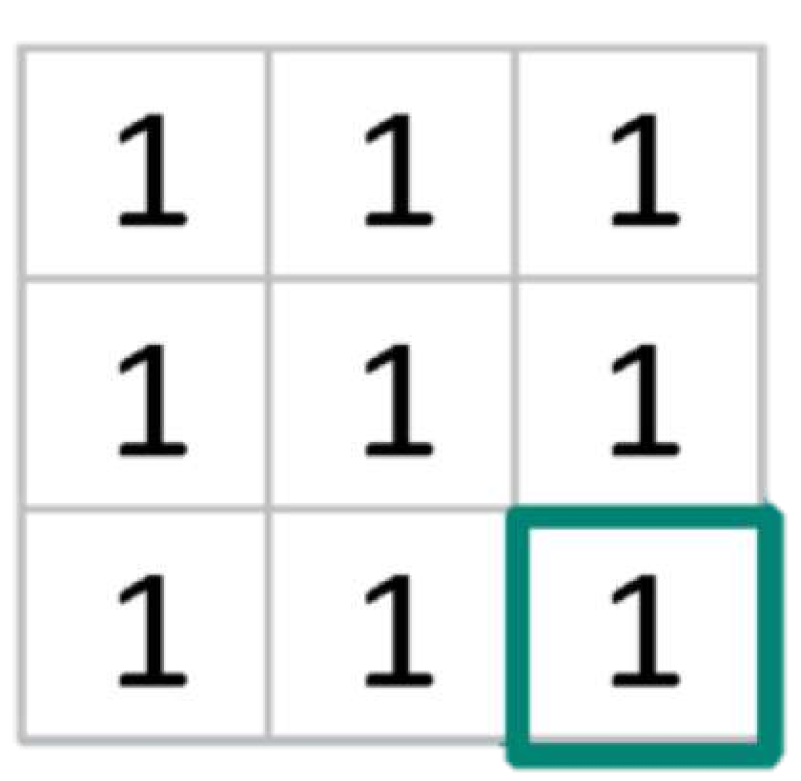
The Convolution Operation
1
X
1
= 1
element wise multiply
add outputs
= 9
[4] 1/29/19

Slide 26
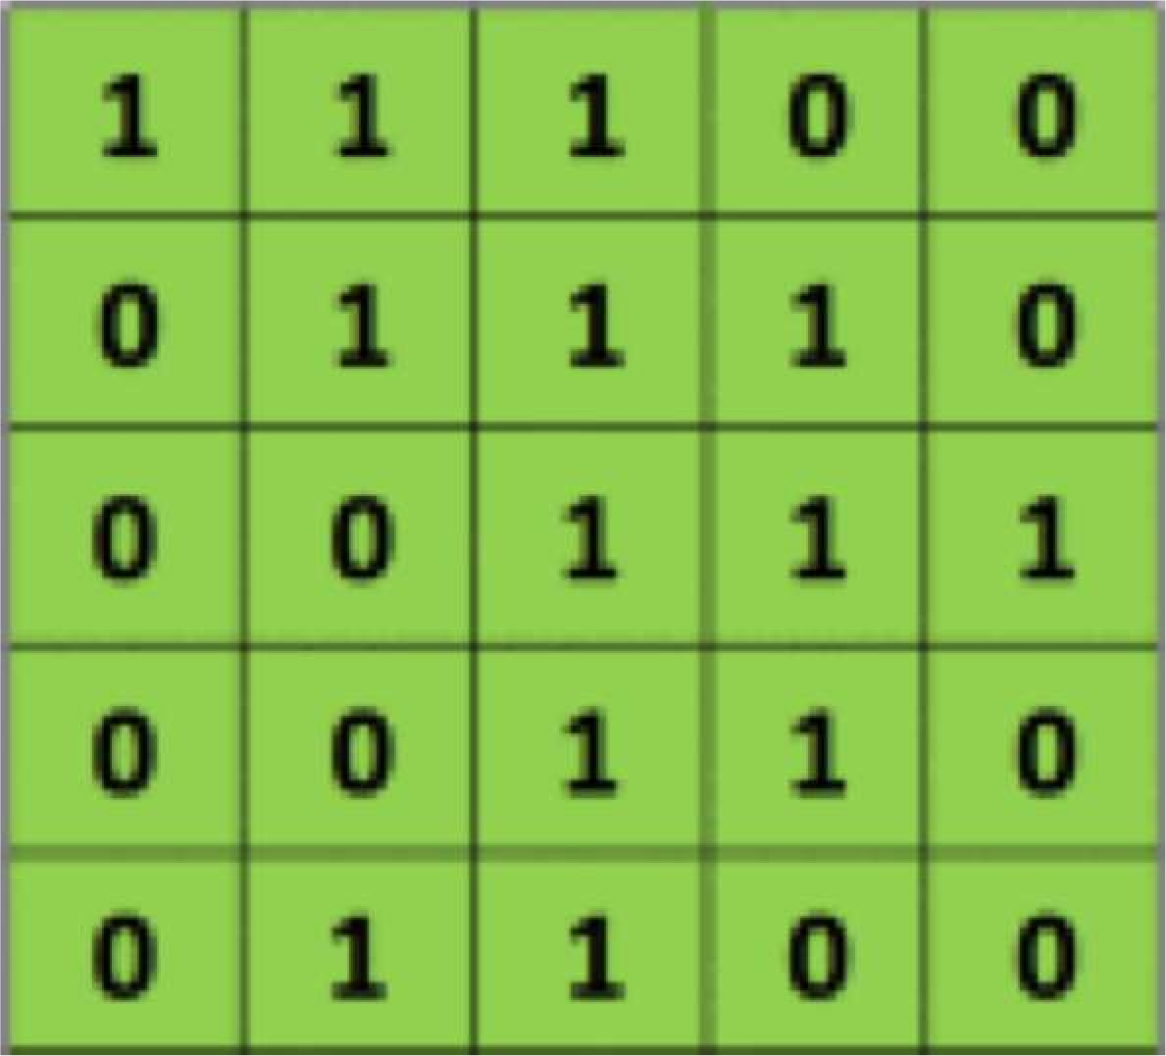
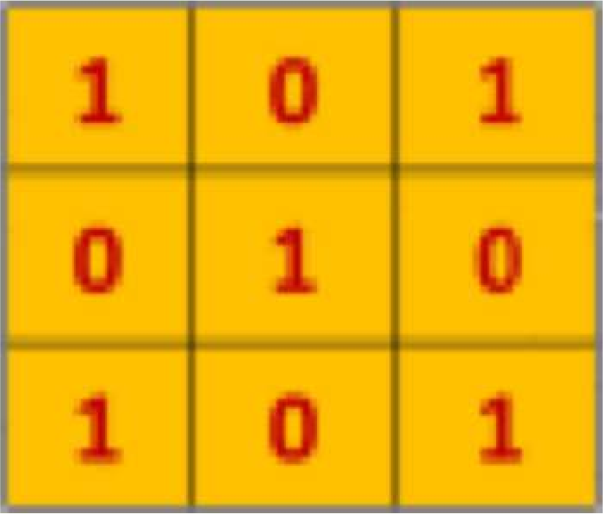
The Convolution Operation
Suppose we want to compute the convolution of a 5x5 image and a 3x3 filter:
filter
image
We slide the 3x3 filter over the input image, element-wise multiply, and add the outputs…
[5] 1/29/19

Slide 27
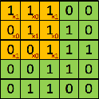
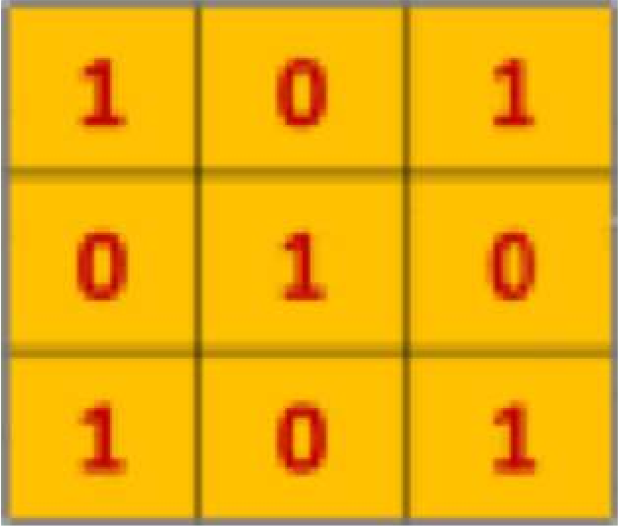
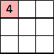
The Convolution Operation
We slide the 3x3 filter over the input image, element-wise multiply, and add the outputs:
filter
feature map
[5] 1/29/19

Slide 28
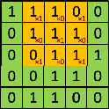
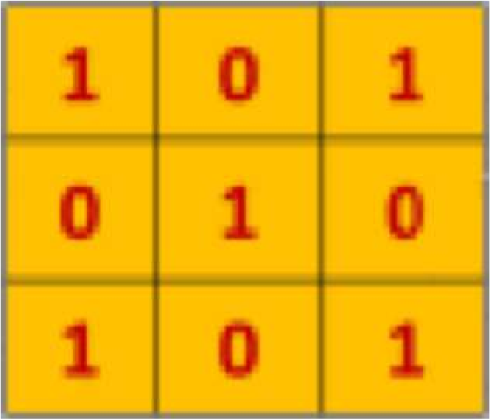
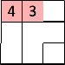
The Convolution Operation
We slide the 3x3 filter over the input image, element-wise multiply, and add the outputs:
filter
feature map
[5] 1/29/19

Slide 29
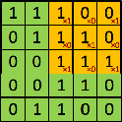
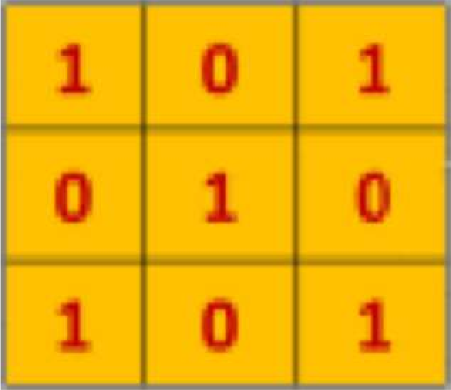
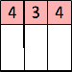
The Convolution Operation
We slide the 3x3 filter over the input image, element-wise multiply, and add the outputs:
filter
feature map
[5] 1/29/19

Slide 30
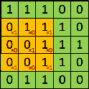
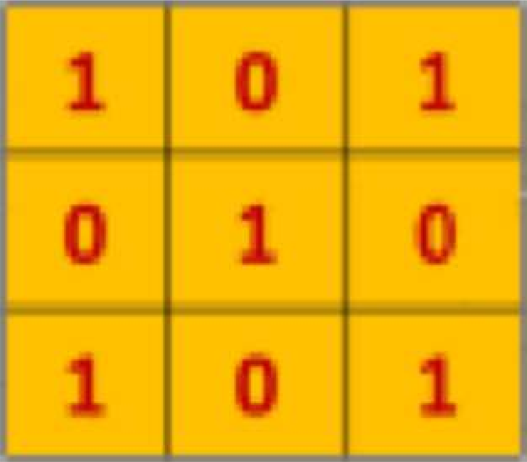
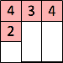
The Convolution Operation
We slide the 3x3 filter over the input image, element-wise multiply, and add the outputs:
filter
feature map
[5] 1/29/19

Slide 31
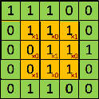
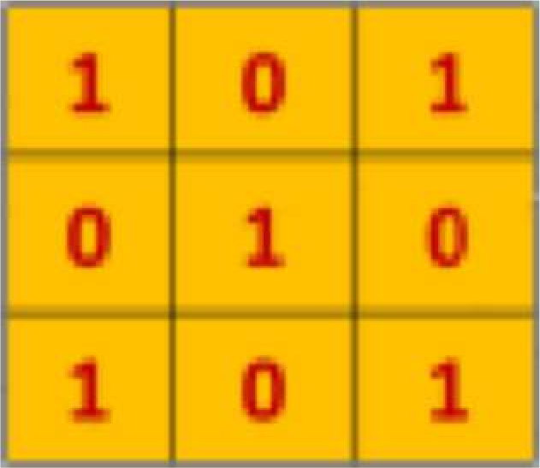
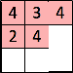
The Convolution Operation
We slide the 3x3 filter over the input image, element-wise multiply, and add the outputs:
filter
feature map
[5] 1/29/19

Slide 32
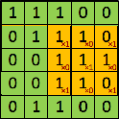
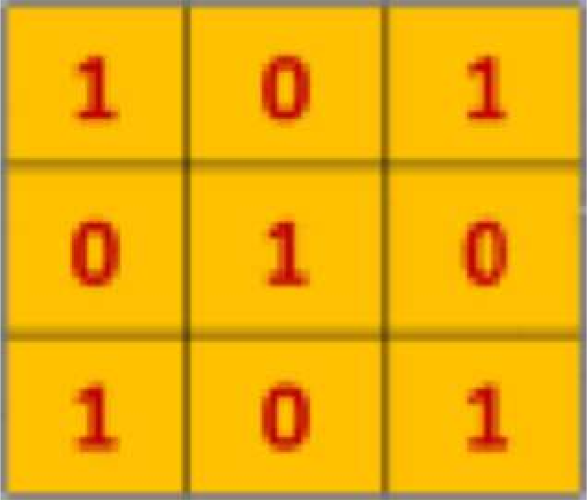
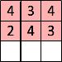
The Convolution Operation
We slide the 3x3 filter over the input image, element-wise multiply, and add the outputs:
filter
feature map
[5] 1/29/19

Slide 33
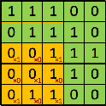
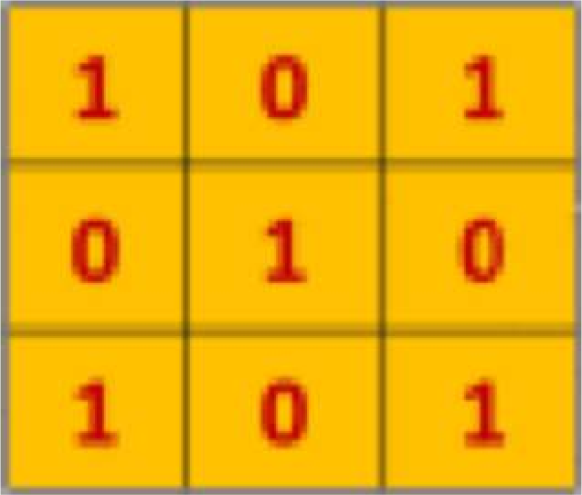
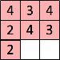
The Convolution Operation
We slide the 3x3 filter over the input image, element-wise multiply, and add the outputs:
filter
feature map
[5] 1/29/19

Slide 34
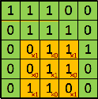


The Convolution Operation
We slide the 3x3 filter over the input image, element-wise multiply, and add the outputs:
filter
feature map
[5] 1/29/19

Slide 35



The Convolution Operation
We slide the 3x3 filter over the input image, element-wise multiply, and add the outputs:
filter
feature map
[5] 1/29/19

Slide 36




Producing Feature Maps
Original
Sharpen
Edge Detect
“Strong” Edge Detect
1/29/19

Slide 37

Feature Extraction with Convolution
Apply a set of weights – a filter – to extract local features
Use multiple filters to extract different features
Spatially share parameters of each filter
1/29/19

Slide 38
Convolutional Neural Networks (CNNs)

Slide 39

CNNs for Classification
Convolution: Apply filters with learned weights to generate feature maps.
Non-linearity: Often ReLU.
Pooling: Downsampling operation on each feature map.
Train model with image data.
Learn weights of filters in convolutional layers.
1/29/19

Slide 40

Convolutional Layers: Local Connectivity
For a neuron in hidden layer:
Take inputs from patch
Compute weighted sum
Apply bias
1/29/19

Slide 41


Convolutional Layers: Local Connectivity
For a neuron in hidden layer:
Take inputs from patch
Compute weighted sum
Apply bias
$$\sum_{i=1}^{4}{\sum_{j=1}^{4}{w_{ij}x_{i+p,j+q}+b}}$$
for neuron (p,q) in hidden layer
4x4 filter: matrix of weights $w_{ij}$
applying a window of weights
computing linear combinations
activating with non-linear function
1/29/19

Slide 42


CNNs: Spatial Arrangement of Output Volume
depth
Layer Dimensions:
$h ×w×d$
where h and w are spatial dimensions
height
d (depth) = number of filters
Stride:
Filter step size
Receptive Field: Locations in input image that a node is path connected to
width
[3] 1/29/19

Slide 43
Convolution Layer
32x32x3 image
32
height
32
width
3
Depth (color)

Slide 44
Convolution Layer
32x32x3 image
5x5x3 filter
32
Convolve the filter with the image
i.e. “slide over the image spatially, computing dot products”
32
3

Slide 45
Convolution Layer
Filters always extend to the full depth of the input volume
32x32x3 image
5x5x3 filter
32
Convolve the filter with the image
i.e. “slide over the image spatially, computing dot products”
32
3

Slide 46


Convolution Layer
32x32x3 image
5x5x3 filter
32
1 number:
the result of taking a dot product between the filter and a small 5x5x3 chunk of the image
(i.e. 5*5*3 = 75-dimensional dot product + bias)
32
3

Slide 47
Convolution Layer
activation map
32x32x3 image
5x5x3 filter
32
28
convolve (slide) over all spatial locations
32
28
3
1

Slide 48
Convolution Layer
consider a second, green filter
32x32x3 image
5x5x3 filter
activation maps
32
28
convolve (slide) over all spatial locations
32
28
3
1

Slide 49
Convolution Layer
For example, if we had 6 5x5 filters, we’ll get 6 separate activation maps:
activation maps
32
28
Convolution Layer
32
28
3
6
We stack these up to get a “new image” of size 28x28x6!

Slide 50
Convolution Layer
Preview: ConvNet is a sequence of Convolution Layers, interspersed with non-linear activation functions
32
28
CONV,
ReLU
e.g. 6 5x5x3 filters
32
28
3
6

Slide 51
Preview: ConvNet is a sequence of Convolution Layers, interspersed with non-linear activation functions
32
28
24
….
CONV,
ReLU
e.g. 6 5x5x3 filters
CONV,
ReLU
e.g. 10 5x5x6 filters
CONV,
ReLU
32
28
24
3
6
10

Slide 52

Recall

Slide 53


convolving the first filter in the input gives the first slice of depth in output volume

Slide 54
A closer look at spatial dimensions:
activation map
32x32x3 image
5x5x3 filter
32
28
convolve (slide) over all spatial locations
32
28
3
1

Slide 55
A closer look at spatial dimensions:
7
7x7 input (spatially)
assume 3x3 filter
7

Slide 56
A closer look at spatial dimensions:
7
7x7 input (spatially)
assume 3x3 filter
7

Slide 57
A closer look at spatial dimensions:
7
7x7 input (spatially)
assume 3x3 filter
7

Slide 58
A closer look at spatial dimensions:
7
7x7 input (spatially)
assume 3x3 filter
7

Slide 59
A closer look at spatial dimensions:
7
7x7 input (spatially)
assume 3x3 filter
=> 5x5 output
7

Slide 60
A closer look at spatial dimensions:
7
7x7 input (spatially)
assume 3x3 filter
applied with stride 2
7

Slide 61
A closer look at spatial dimensions:
7
7x7 input (spatially)
assume 3x3 filter
applied with stride 2
7

Slide 62
A closer look at spatial dimensions:
7
7x7 input (spatially)
assume 3x3 filter
applied with stride 2
=> 3x3 output!
7

Slide 63
N
Output size:
(N - F) / stride + 1
e.g. N = 7, F = 3:
stride 1 => (7 - 3)/1 + 1 = 5
stride 2 => (7 - 3)/2 + 1 = 3
F
F
N

Slide 64
In practice: Common to zero pad the border
0 | 0 | 0 | 0 | 0 | 0
0
0
0
0
Aside: remove image mean first!
e.g. input 7x7
3x3 filter, applied with stride 1
pad with 1 pixel border => what is the output?
(recall:)
(N - F) / stride + 1

Slide 65
In practice: Common to zero pad the border
0 | 0 | 0 | 0 | 0 | 0
0
0
0
0
e.g. input 7x7
3x3 filter, applied with stride 1
pad with 1 pixel border => what is the output?
7x7 output!

Slide 66
In practice: Common to zero pad the border
0 | 0 | 0 | 0 | 0 | 0
0
0
0
0
e.g. input 7x7
3x3 filter, applied with stride 1
pad with 1 pixel border => what is the output?
7x7 output!
in general, common to see CONV layers with stride 1, filters of size FxF, and zero-padding with (F-1)/2. (will preserve size spatially)
e.g. F = 3 => zero pad with 1
F = 5 => zero pad with 2
F = 7 => zero pad with 3

Slide 67
Remember back to…
E.g. 32x32 input convolved repeatedly with 5x5 filters shrinks volumes spatially!
(32 -> 28 -> 24 ...). Shrinking too fast is not good, doesn’t work well.
32
28
24
….
CONV,
ReLU
e.g. 6 5x5x3 filters
CONV,
ReLU
e.g. 10 5x5x6 filters
CONV,
ReLU
32
28
24
3
6
10

Slide 68
Examples time:
Input volume: 32x32x3
10 5x5 filters with stride 1, pad 2
Output volume size: ?

Slide 69
Examples time:
Input volume: 32x32x3
10 5x5 filters with stride 1, pad 2
Output volume size:
(32+2*2-5)/1+1 = 32 spatially, so
32x32x10

Slide 70
Examples time:
Input volume: 32x32x3
10 5x5 filters with stride 1, pad 2
Number of parameters in this layer?

Slide 71
Examples time:
Input volume: 32x32x3
10 5x5 filters with stride 1, pad 2
Number of parameters in this layer?
each filter has 5*5*3 + 1 = 76 params (+1 for bias)
=> 76*10 = 760

Slide 72


Slide 73
Common settings:
K = (powers of 2, e.g. 32, 64, 128, 512)
F = 3, S = 1, P = 1
F = 5, S = 1, P = 2
F = 5, S = 2, P = ? (whatever fits)
F = 1, S = 1, P = 0

Slide 74
Pooling layer
Single depth slice
1 | 1 | 2 | 4
5 | 6 | 7 | 8
3 | 2 | 1 | 0
1 | 2 | 3 | 4
x
max pool with 2x2 filters and stride 2
6 | 8
3 | 4
Reduced dimensionality
Spatial invariance
y
How else can we downsample and preserve spatial invariance?
[3] 1/29/19

Slide 75



Representation Learning in Deep CNNs
Low level features
Mid level features
High level features
Eyes, ears, nose Conv Layer 2
Edges, dark spots
Conv Layer 1
Facial structure
Conv Layer 3
[3] 1/29/19

Slide 76

CNNs for Classification: Feature Learning
Learn features in input image through convolution
Introduce non-linearity through activation function (real-world data is non-linear!)
Reduce dimensionality and preserve spatial invariance with pooling
1/29/19

Slide 77

CNNs for Classification: Class Probabilities
$$softmax\left(y_{i}\right)=\frac{e^{y_{i}}}{\sum_{j=1}^{n}{e^{y_{j}}}}$$
CONV and POOL layers output high-level features of input
Fully connected layer uses these features for classifying input image
Express output as probability of image belonging to a particular class
1/29/19

Slide 78

CNNs:Training with Backpropagation
Learn weights for convolutional filters and fully connected layers Backpropagation: cross-entropy loss
$$J\left(W\right)=\sum_{i}{y_{i}}\log{{\hat{y}}_{i}}$$
1/29/19

